Slide 1
L6 Group 1
Alice Baker
Beth Cowle
Amy Potter
Daniel Pokladek

Slide 2
Idea 1: Market Overview
Cooperative Puzzle Game
Platform - PC, potential for mobile
Mid-core/hardcore gamers
Male/Female
18-35
Bartle’s Taxonomy of Player Types
Achievers and Socialisers
Notes:
Since 32% of gamers play on their PC/Laptops, we have chosen to market our game for the PC platform. If the game is networked, we would ideally port the game to mobile as well. Since 33% of gamers play on a mobile device, the combination of the two would allow us to cover a large percentage of the market.
We feel that our game is suited to mid-core and hardcore gamers since the implementation of strategy and mastery may deter casual gamers due to the increased element of skill required
We have chosen to market our game for both males and females between the ages of 18 and 35. When looking at strategyr, social gamers are 54% female and 46% male, since there is a fairly equal balance between the two, it makes sense to cater our game to both genders. Furthermore, it makes sense not to target a much younger audience due to our theme, while the small elements of twitch mechanics may rule out those who are older.
Due to the nature of communication required during gameplay, we feel that our game will attract socialisers. In addition to this, we feel that achievers would be attracted to our game since players can create their own goals, such as collecting all character customisation pieces.

Slide 3
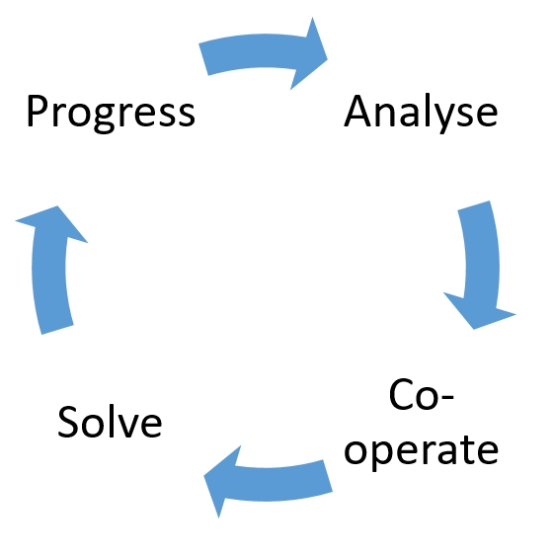
Idea 1: What Does the Player Do?
Core Game Loop
Notes:
When the players enter a room, they must both analyse the puzzle that has been presented to them and come up with an appropriate solution together. They must then co-operate verbally and guide one another if needed in order to solve the puzzle and progress to the next area.
While we originally intended to introduce a different type of puzzle for every level, we have now decided to hone in on a learn, practice, master loop by introducing new puzzle elements into the dungeon, after the player has the opportunity to master the skills that were required for the previous puzzles.

Slide 4
Idea 1: Player Experience
Mechanics, Gameplay; Types of fun etc.
Strategy
Fiero
People fun
Co-operation
Communication to achieve amiero
Hard fun
Obstacles
Notes:
There is a large focus on hard fun in our game since the players must work together in order to create a strategy and work towards the goal of solving each puzzle. In particular, the hard fun is achieved by providing the players with a problem for which they must communicate in order to find the solution.
We intend to create an element of progression in our learn, practice, master loop by adding a limited set of new mechanics, such as obstacles, as well as making small tweaks to the pre-existing mechanics that players may have already learnt.
The people fun element of our game comes from the enjoyment of playing with others. In particular, the requirement of cooperation and communication in order to progress will achieve amiero or social bonding, as well as amusement, especially in situations where a player may choose to sabotage their partner in order to laugh at them.
LeBlanc’s Taxonomy of Game Pleasures (challenge, fellowship and discovery)

Slide 5
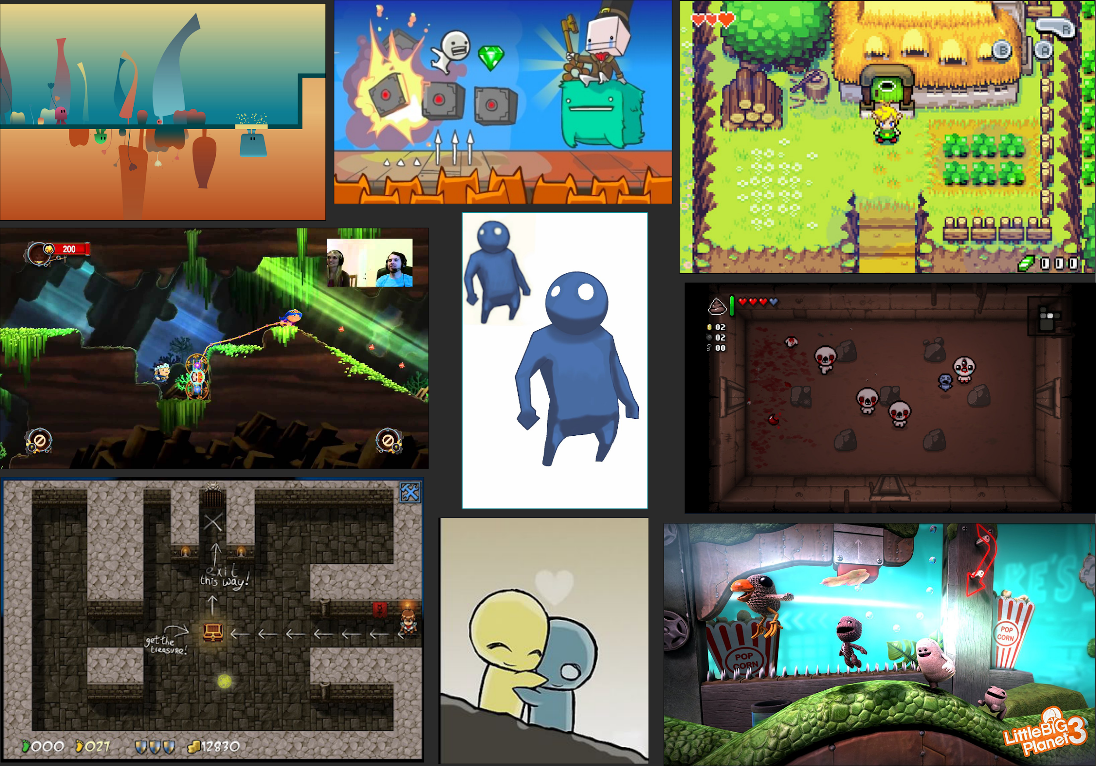
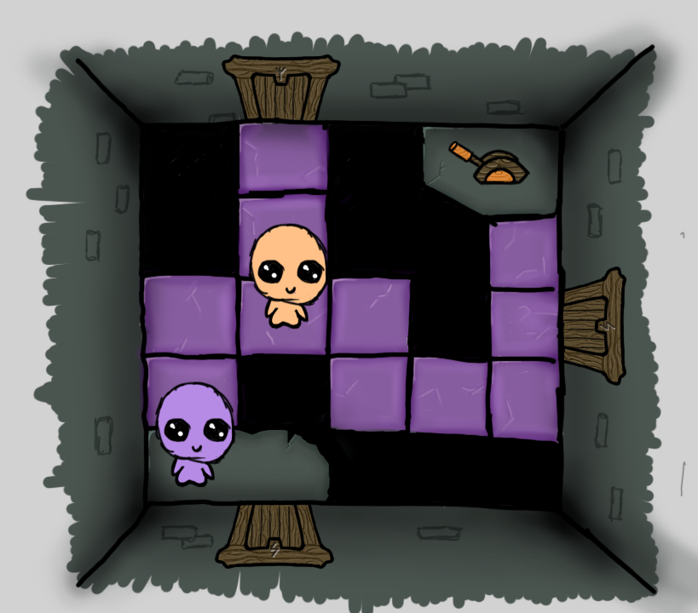
Mood boards/Concept Drawings
Notes:
For my mood board, I looked at different areas that I wanted to use as influence for my concept art
In particular, I focused on similar games on the market, such as Battleblock Theater, as well as those which employed the perspective we were looking to use in our game.
As you can see, we have chosen to go with an angled top down perspective, similar to that seen in The Binding of Isaac.
I chose to create genderless characters and I feel that this works particularly well in consideration of the traits of a good relationship since it does not single out any gender or sexuality preferences.
My colour choice for the characters and interactable objects was also influenced by color blindness options that are seen in most mainstream games today. Where the colours of the player characters match that of the object that they can pass through, see and interact with.
In this example, the orange player cannot see the purple tiles and the purple player cannot pass through the orange barrier at the start of the path, until his partner has activated the lever.

Slide 6
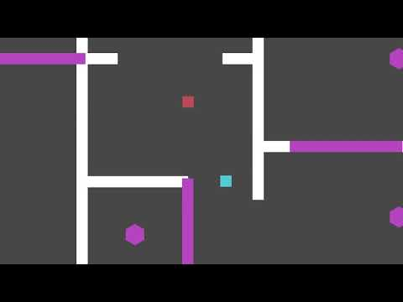
Prototype

Slide 7
Idea 2: Market Overview
Planet Management/Sorting Game
Platform - Mobile
Casual gamers
Female
Middle aged
Bartle’s Taxonomy of Player Types
Explorers
Achievers

Slide 8
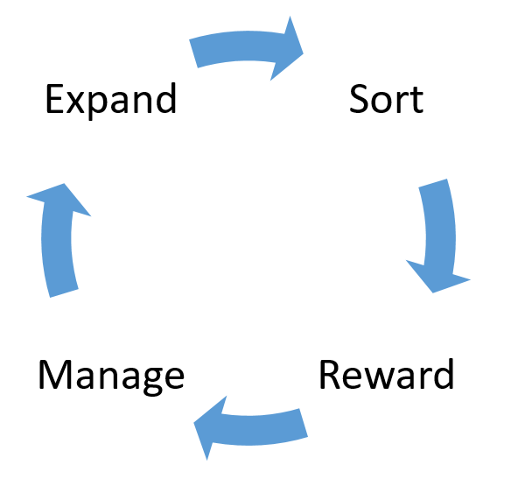
Idea 2: What Does the Player Do?
Core Game Loop

Slide 9
Idea 2: Player Experience
Mechanics, Gameplay; Types of fun etc.
Sorting mechanic
Management mechanic
Curiosity
Serious fun
Easy fun
Variable reward schedule
Endowment effect
Loss aversion

Slide 10
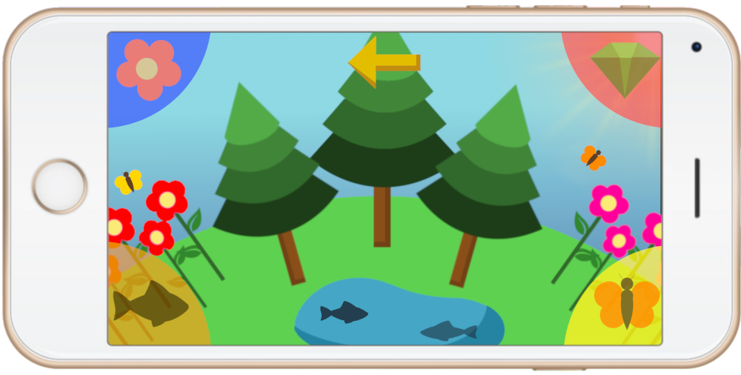
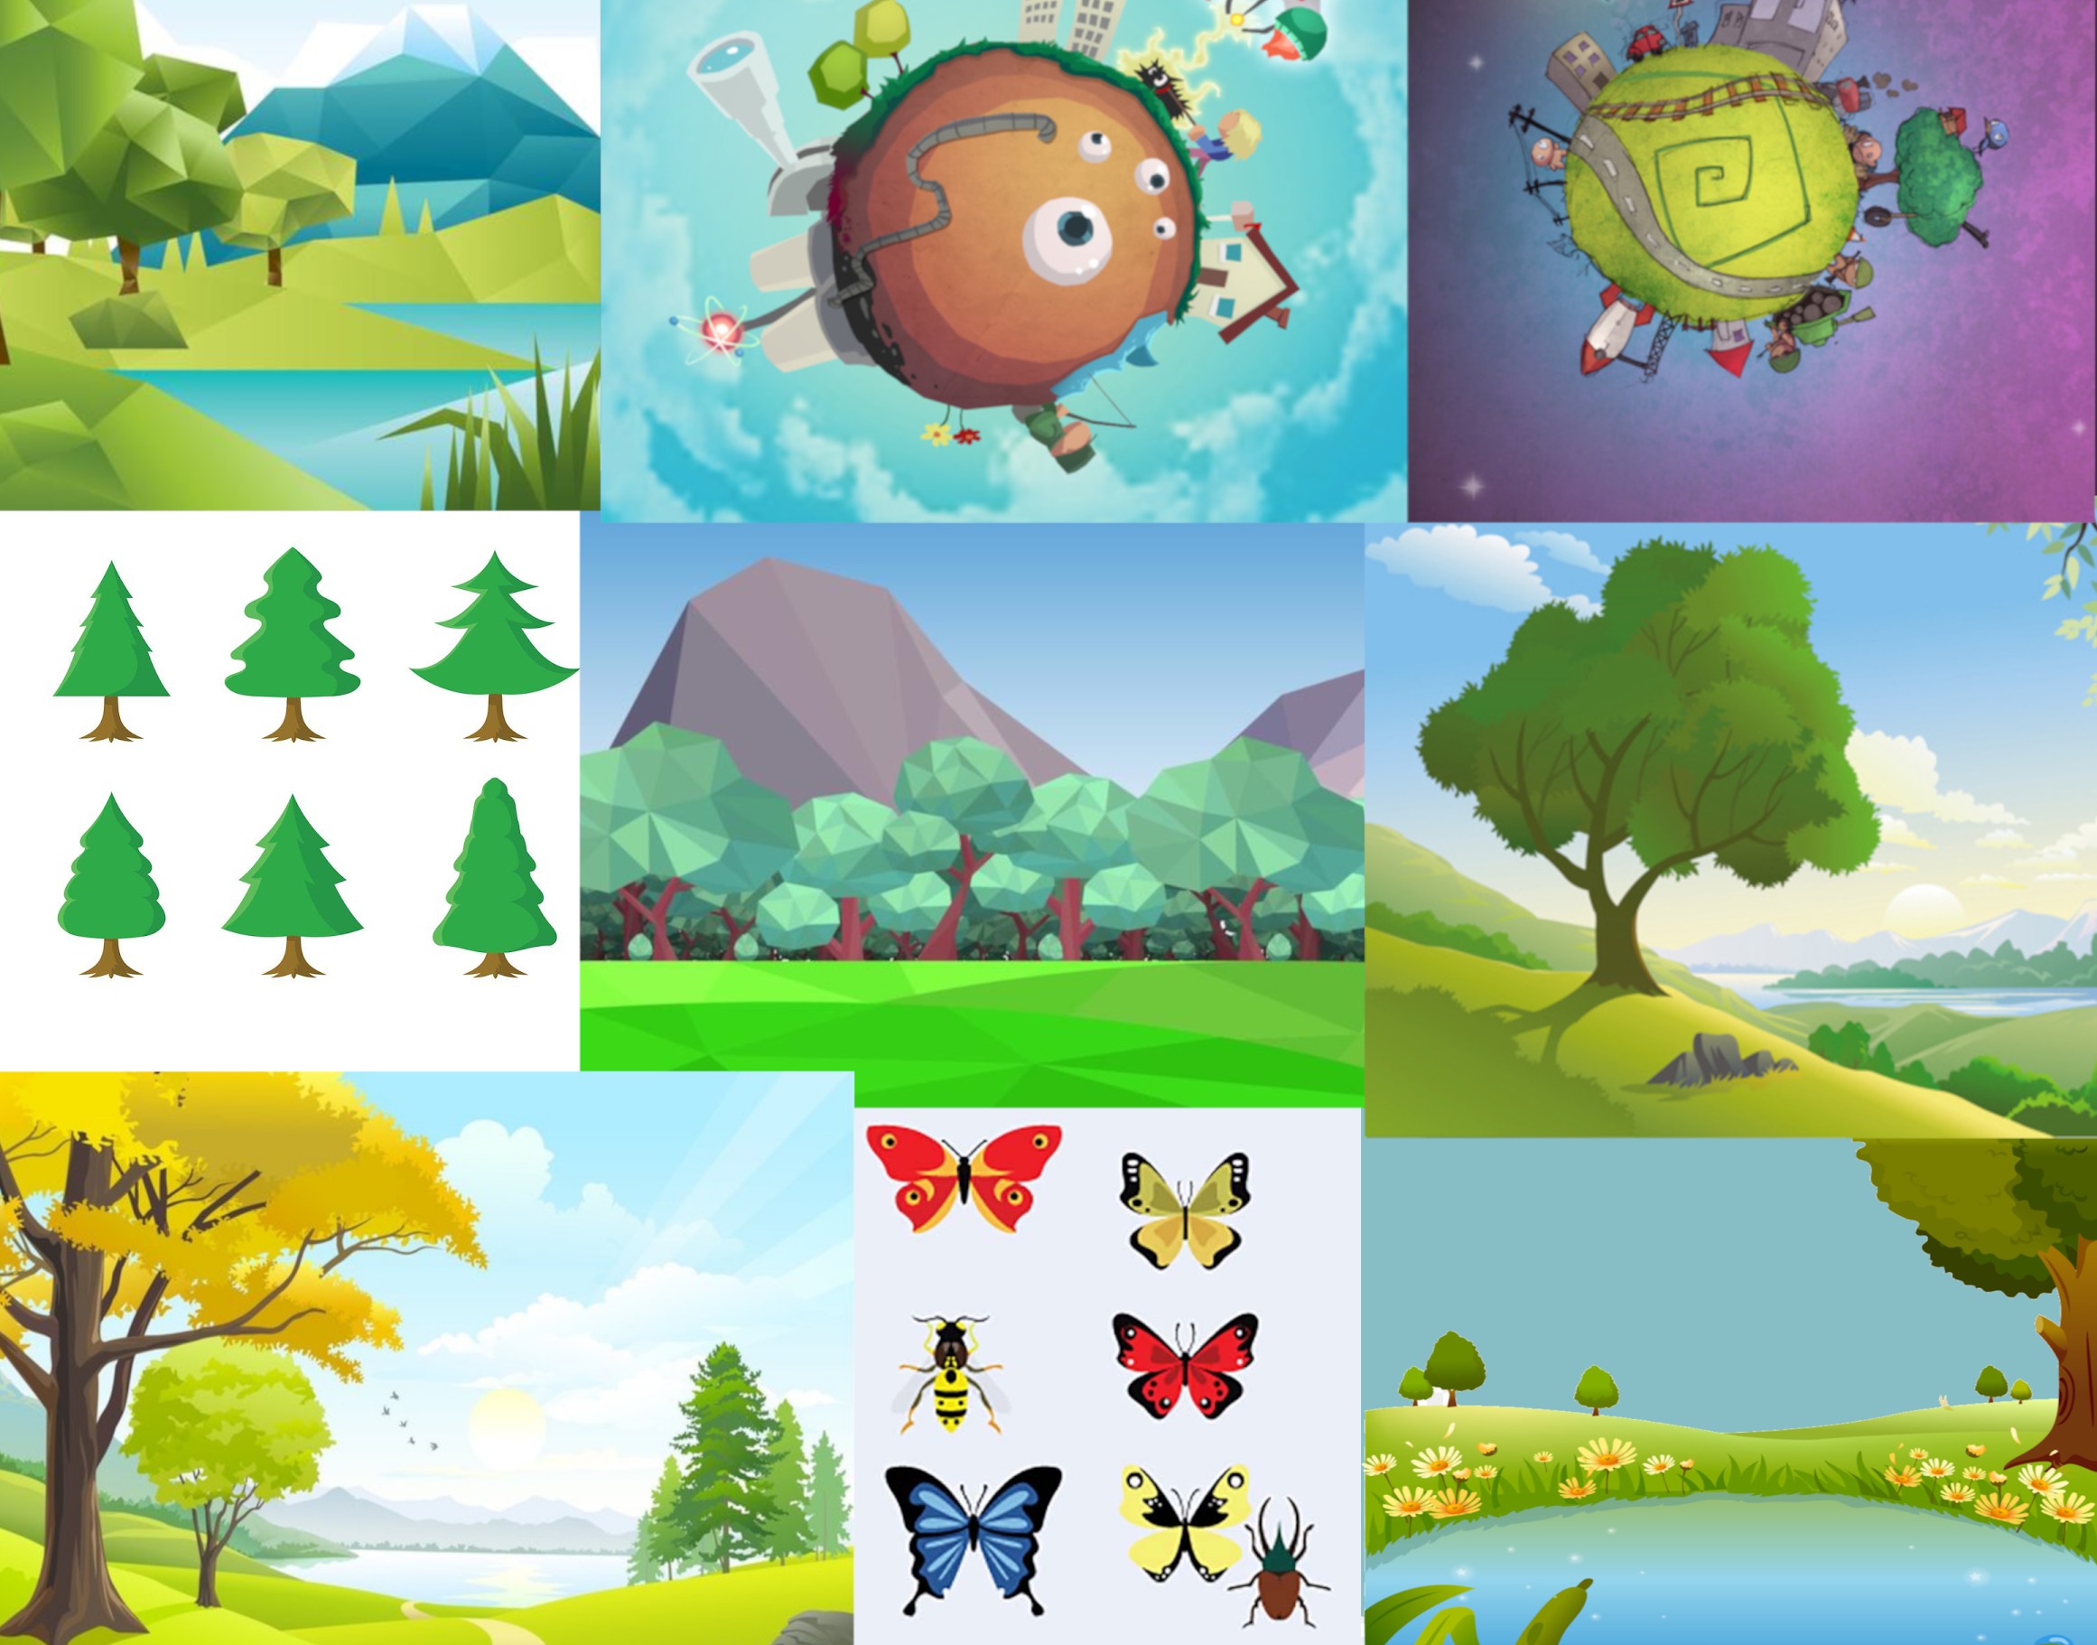
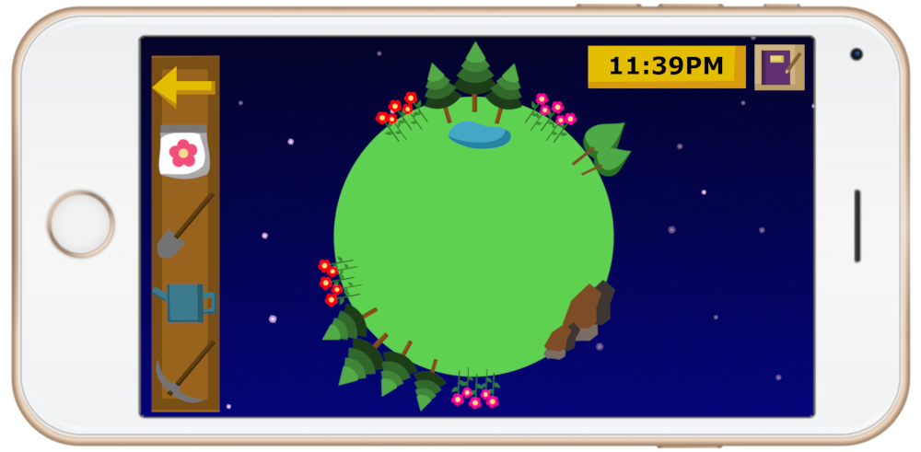
Mood boards/Concept Drawings

Slide 11
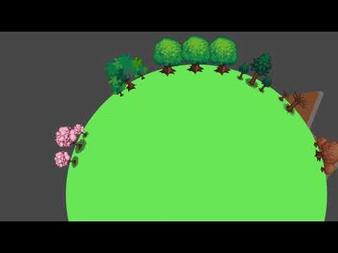
Prototype

Slide 12
Idea 3: Market Overview
Casual Multiplayer Mobile Game - Adaptation of ‘Statues’
Platform - Mobile
Casual
Male and Female
Ages 7 - 35
Competition and Trial & Error
Leblanc’s Taxonomy of Game Pleasures
Challenge and Fellowship
Bartle’s Taxonomy of Player Types
Achievers and Socializers

Slide 13
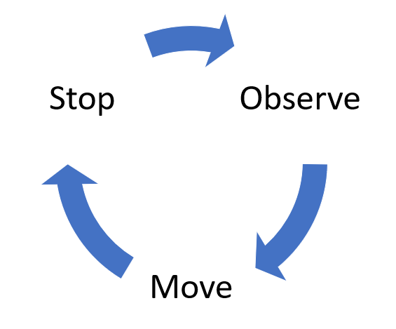
Idea 3: What Does the Player Do?
Core Game Loop
Twitch mechanic

Slide 14
Idea 3: Player Experience
Schadenfreude
Placing obstacles to sabotage your friends
Fiero
Overcoming struggles of gameplay
Frustration
Being set back by opponents
Tension and Release -
Anticipation of items and predator. (Risk and Reward)
Immersion
Requires constant attention
Negative Feedback Loop
Players left behind can obtain useful items

Slide 15
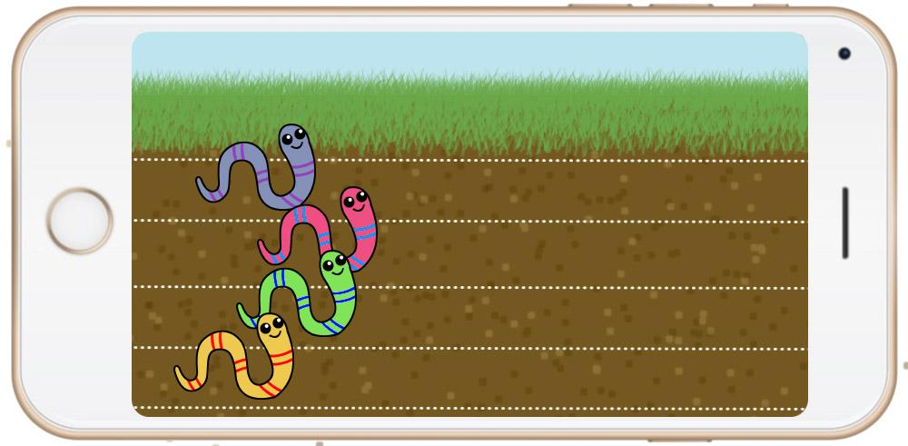
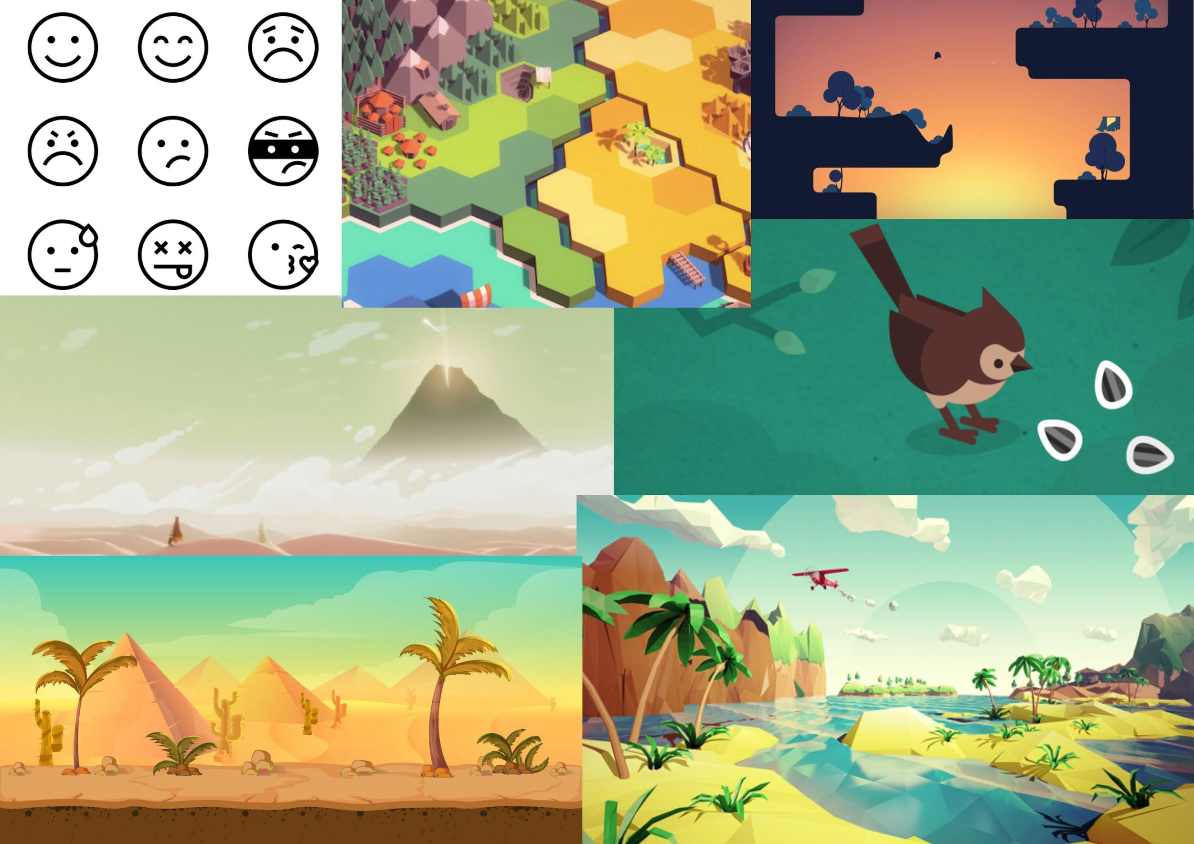
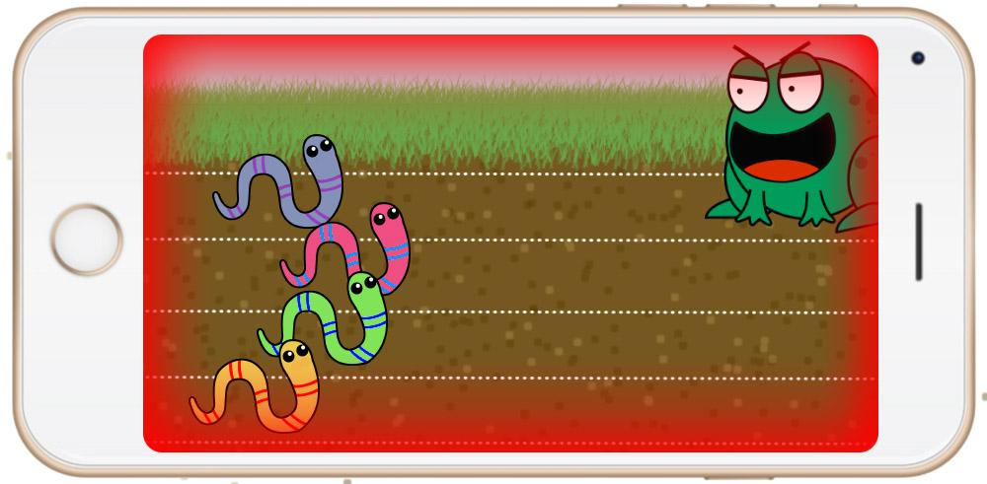
Mood boards/Concept Drawings

Slide 16
Any Questions?

